Slide 1
Data Mining Software. Introduction to Orange Data Mining

Slide 2
Data Mining Software
Commercial
IBM SPSS Modeler (formerly Clementine)
SAS - Enterprise Miner
IBM - Intelligent Miner
StatSoft – Statistica Data Miner
… many more
Free and/or Open Source
R
RapidMiner
Orange Data Mining
Weka…
Source: KDNuggets.com

Slide 3

Orange
open-source data visualization, machine learning and data mining toolkit
Freeware (you can get it from here https://orange.biolab.si/)
User friendly, drag and drop (visual programming) suite
features explorative data analysis and interactive data visualization
Range of powerful widgets add-ons (social network analysis, bioinformatics, geo tagging, image analytics, text mining etc.)
Does not require knowledge of maths and statistics

Slide 4

Let’s get a taste of Orange
Video 1
Video 2

Slide 5
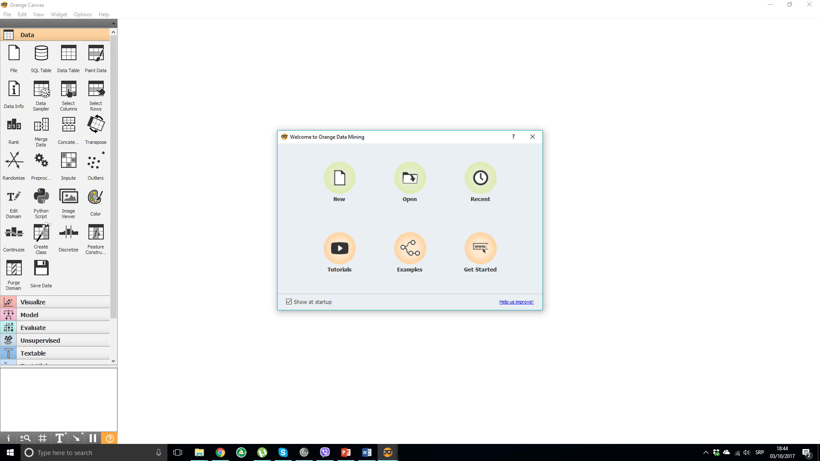

Slide 6
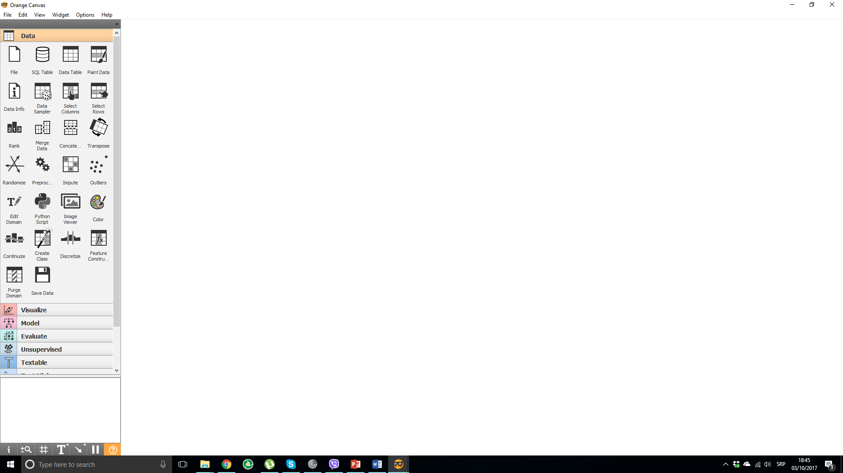
This is blank CANVAS. This is where you build your workflows

Slide 7
These are widgets (computational units) that have their inputs and outputs.
You can place them on canvas via drag and drop
You can think of them as a black box that has some defined functionality
Set of tools for labeling, zooming or pausing model flow

Slide 8
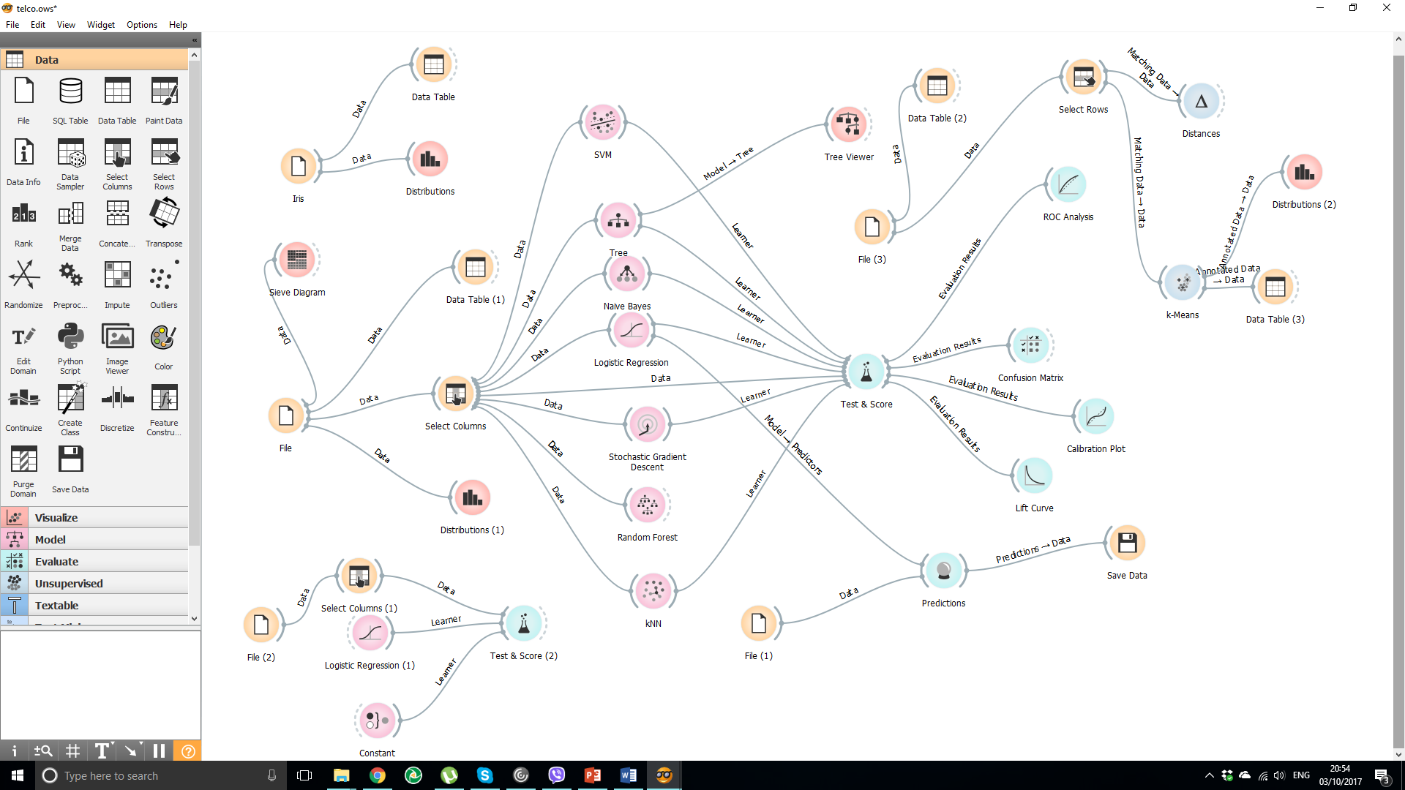
Workflow example

Slide 9
Supported files
Orange files have .ows extension (workflows)
Orange works with tab, xls, csv files as well as sql tables
Orange can also work with text files (text mining)

Slide 10
Imporant sources for learning Orange
Orange Data Mining YouTube channel
Orange internet page
Orange toolbox

Slide 11
What can you do in Orange
Explore and munge data
Visualise data
Cluster/segment data
Discover patterns in data
Make predictions
Scrape contents from social media
Perform text analysis
Much more

